Slide 1
Mastering Microsoft Graph PowerShell
Merill Fernando
@merill
merill.net

Slide 2


Slide 3
What is Microsoft Graph PowerShell?

Slide 4
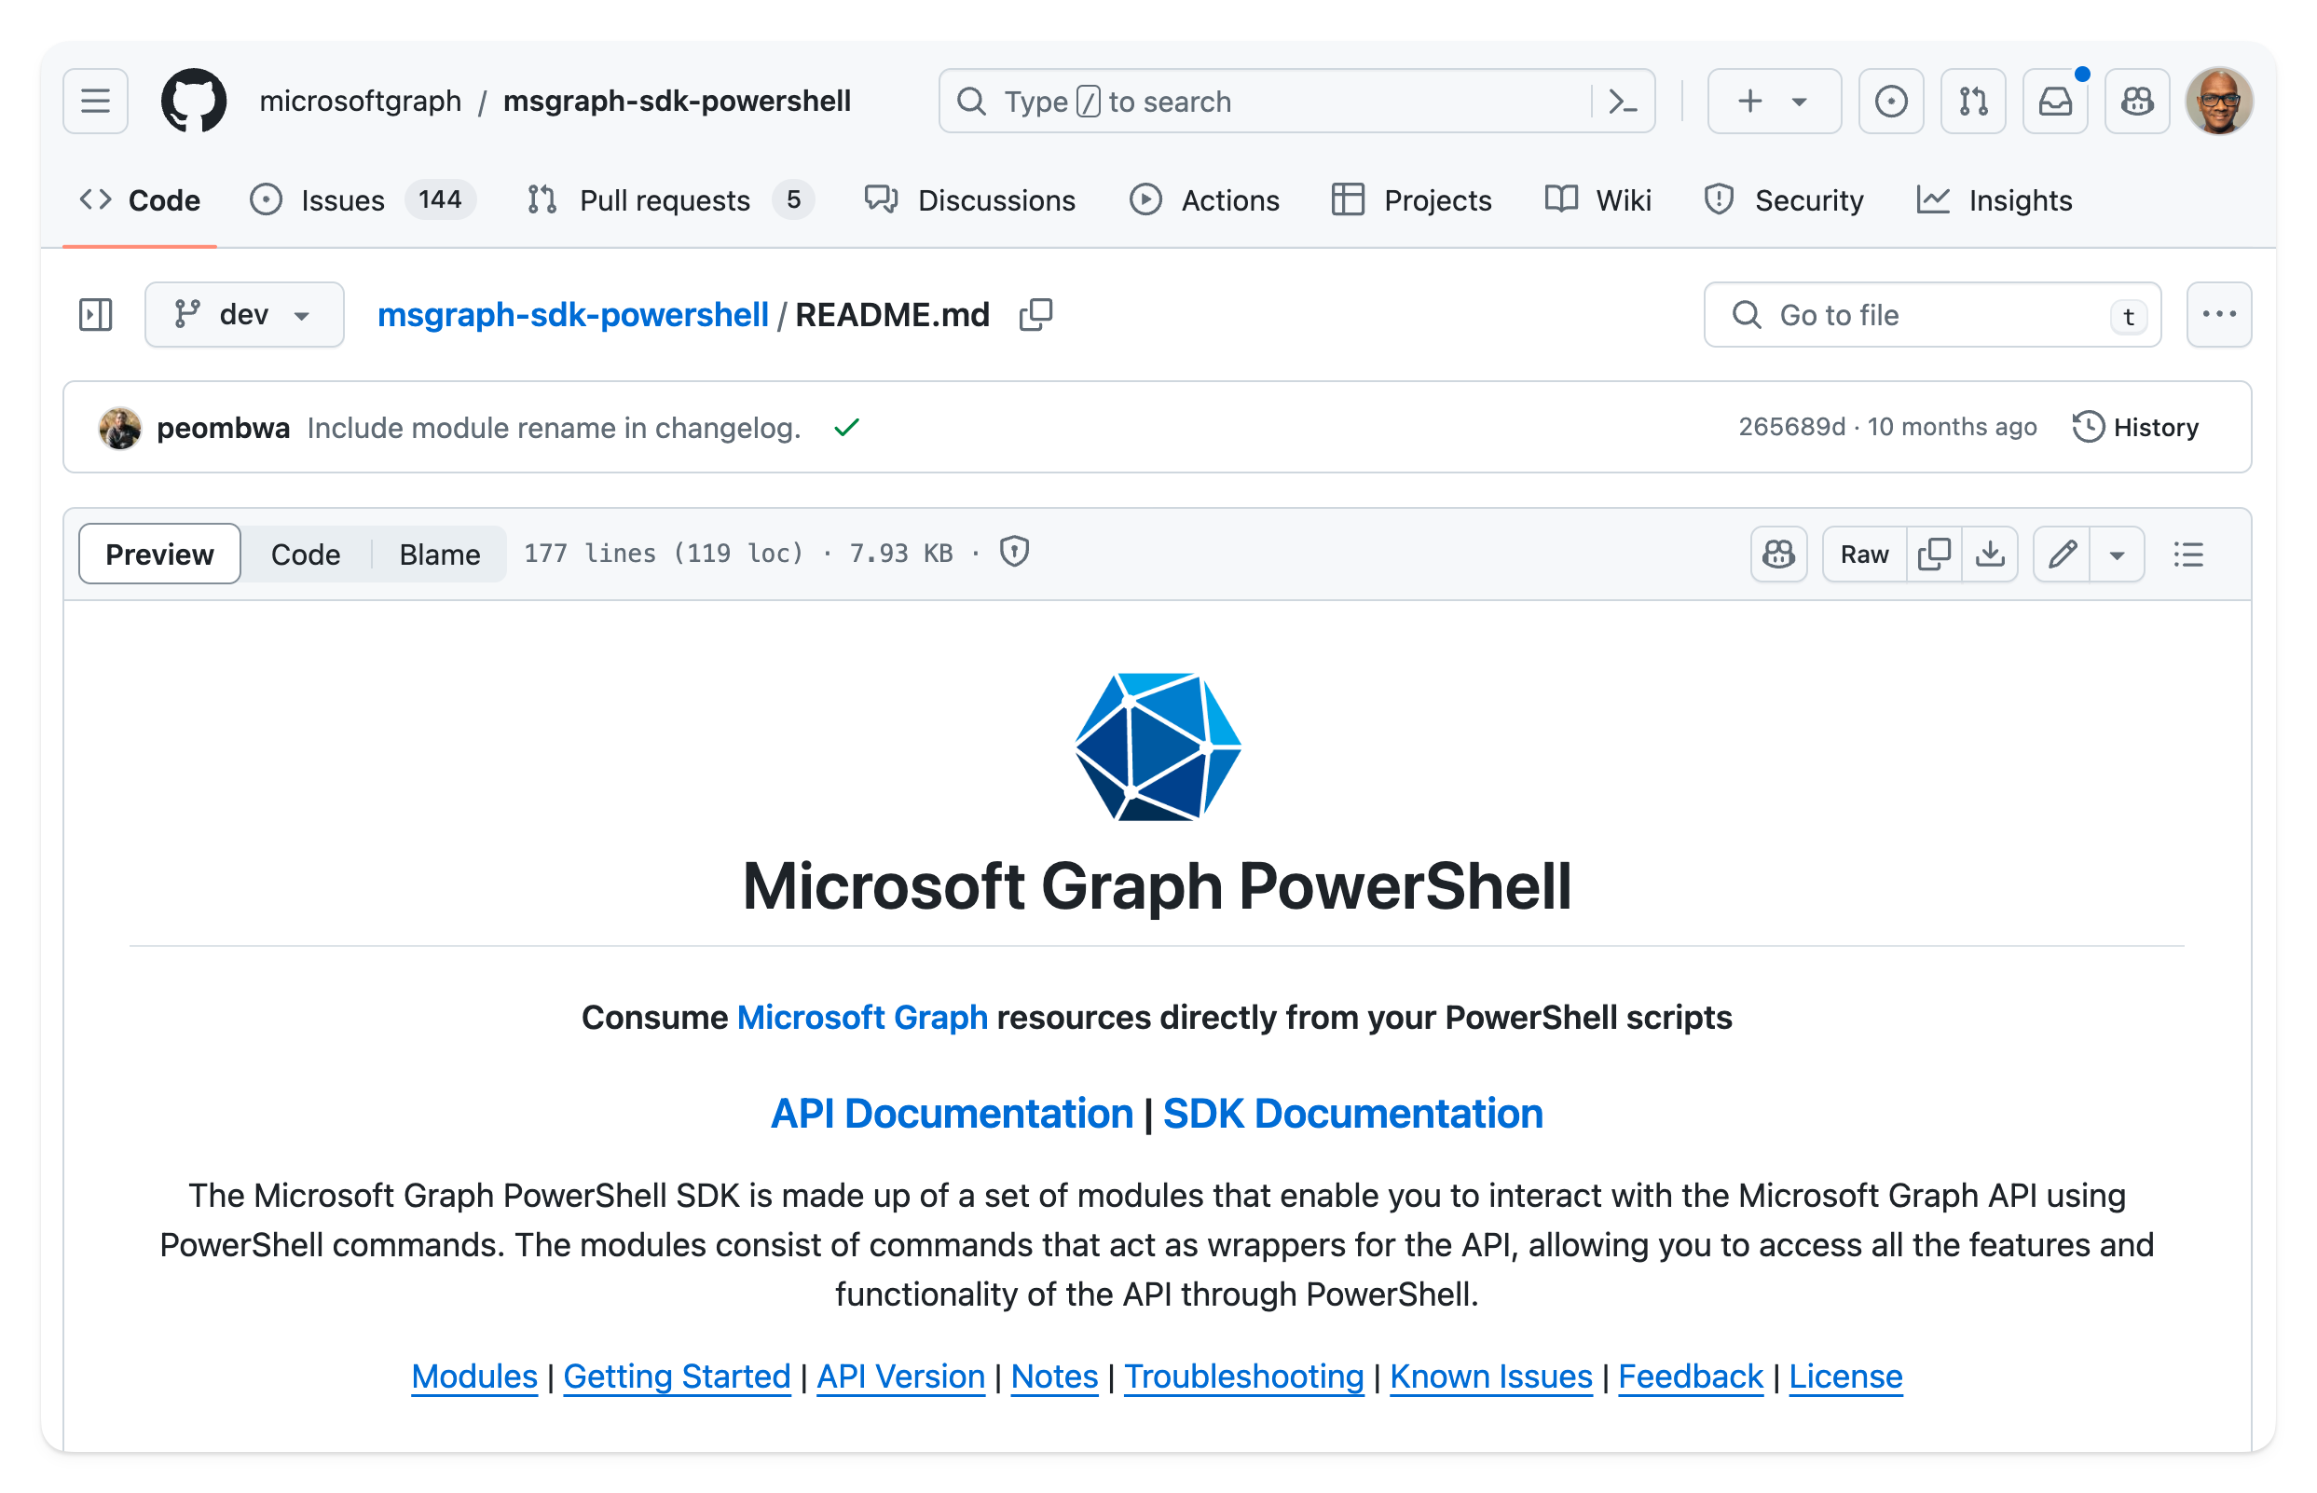
Microsoft Graph PowerShell is…
A wrapper over the Microsoft Graph API
Open source
Monthly/fortnightly releases (bug fixes, new features)
Code generated using AutoRest

Slide 5
From Graph API to Graph PowerShell
REST API
https://graph.microsoft.com/v1.0/users?$filter=userType eq 'guest'
PowerShell
Get-MgUser -Filter "userType eq 'guest'"

Slide 6
Why Graph PowerShell?

Slide 7
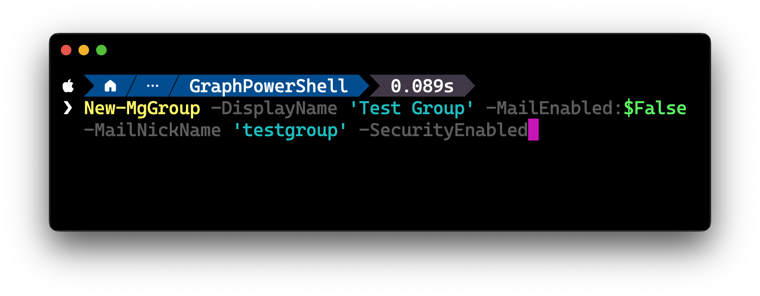
Creating new objects

Slide 8
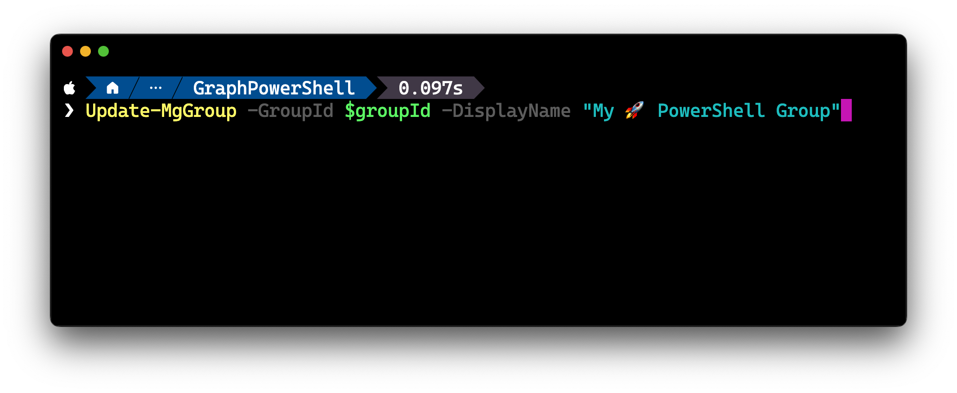
Updating objects

Slide 9
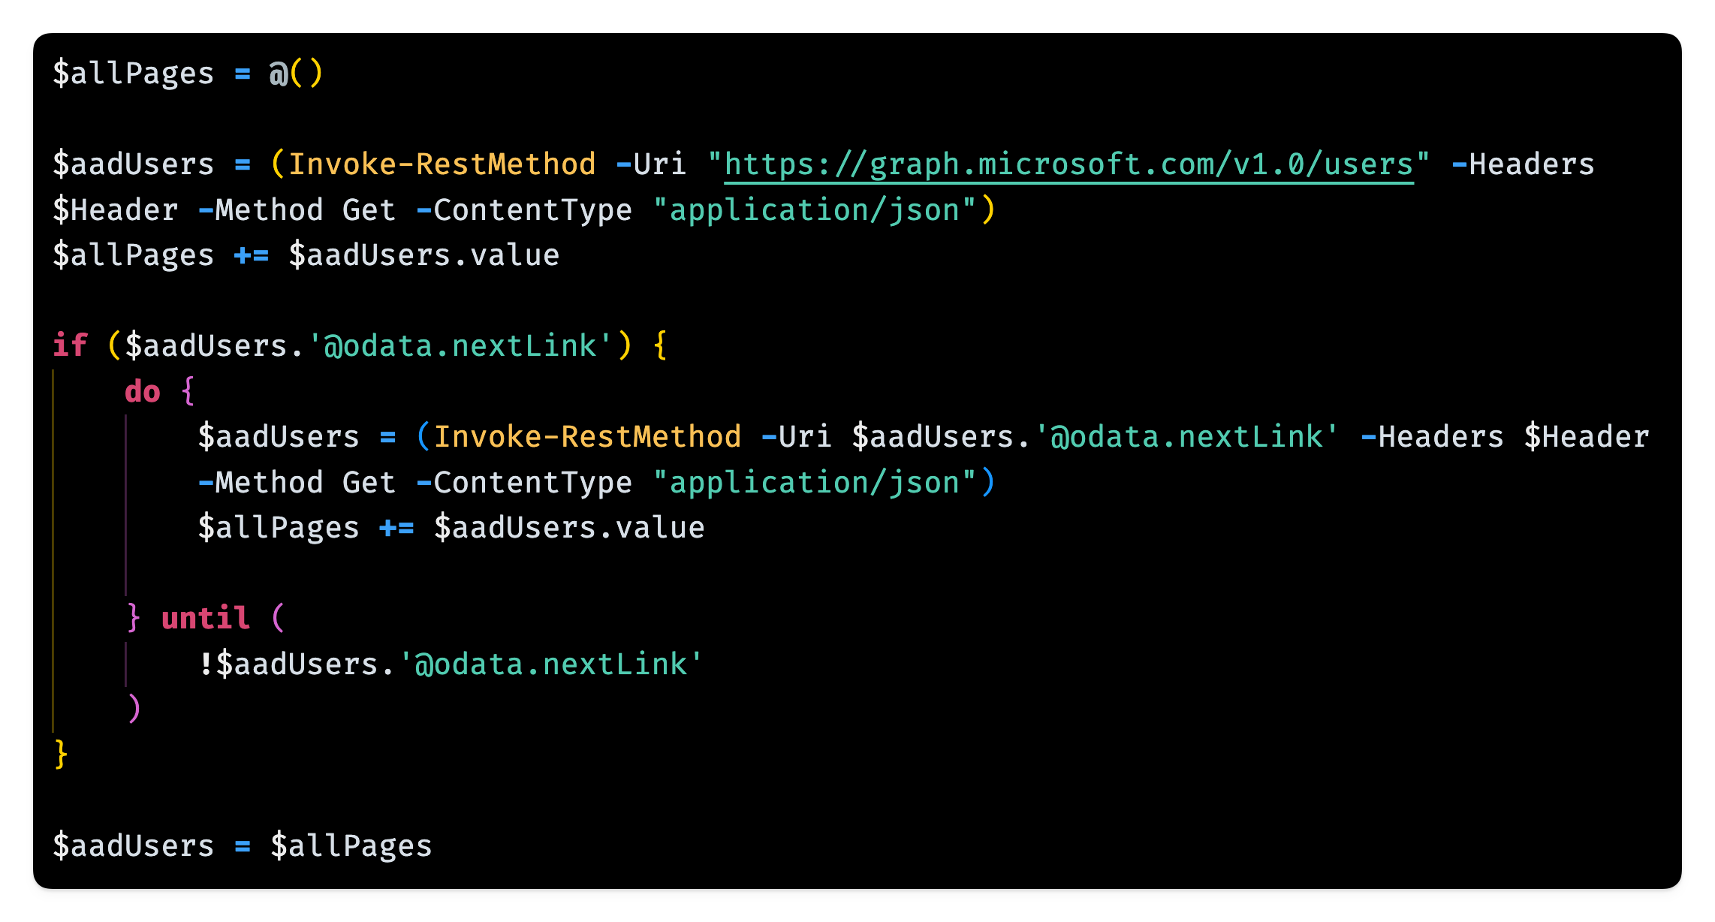

Slide 10

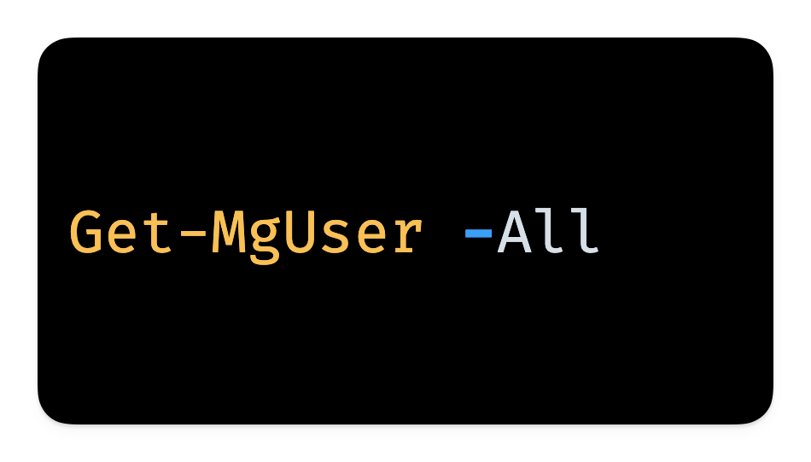

Slide 11
Authenticating with Graph PowerShell

Slide 12
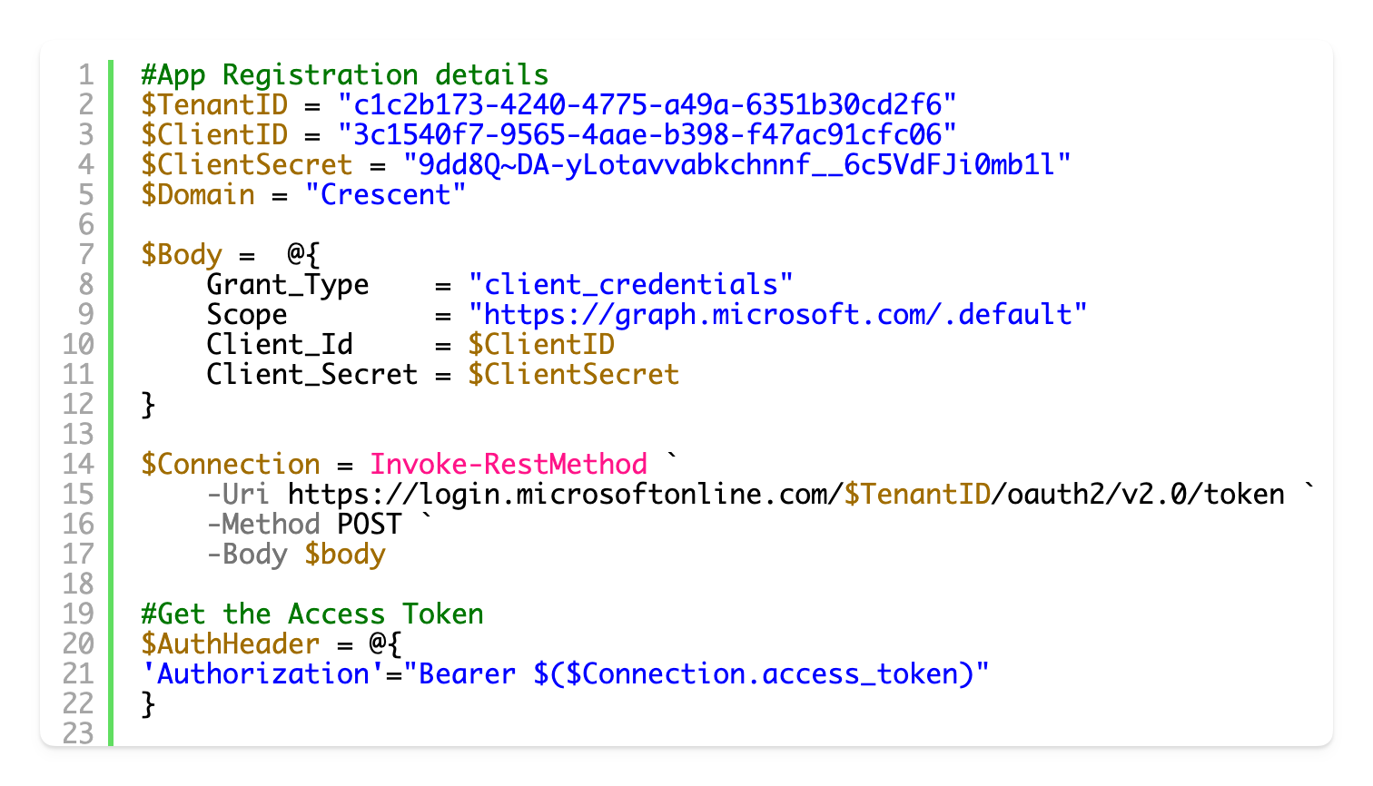

Connecting to Microsoft Graph
Notes:
This type of code litters many scripts and blog posts on the internet. It’s time we stopped this.

Slide 13
Why you should avoid rolling your own authentication code in your scripts… PowerShell scripts with no auth code are more resilient!
Scripts running over an hour will error out
Token needs to be renewed every hour
The fix is NOT to increase token lifetime policies!
To improve an organization’s security posture your IT admins can enforce conditional access policies that can break your script including..
Blocking device code flow
Setting shorter sign-in frequency policies
Enforcing continuous access evaluation

Slide 14
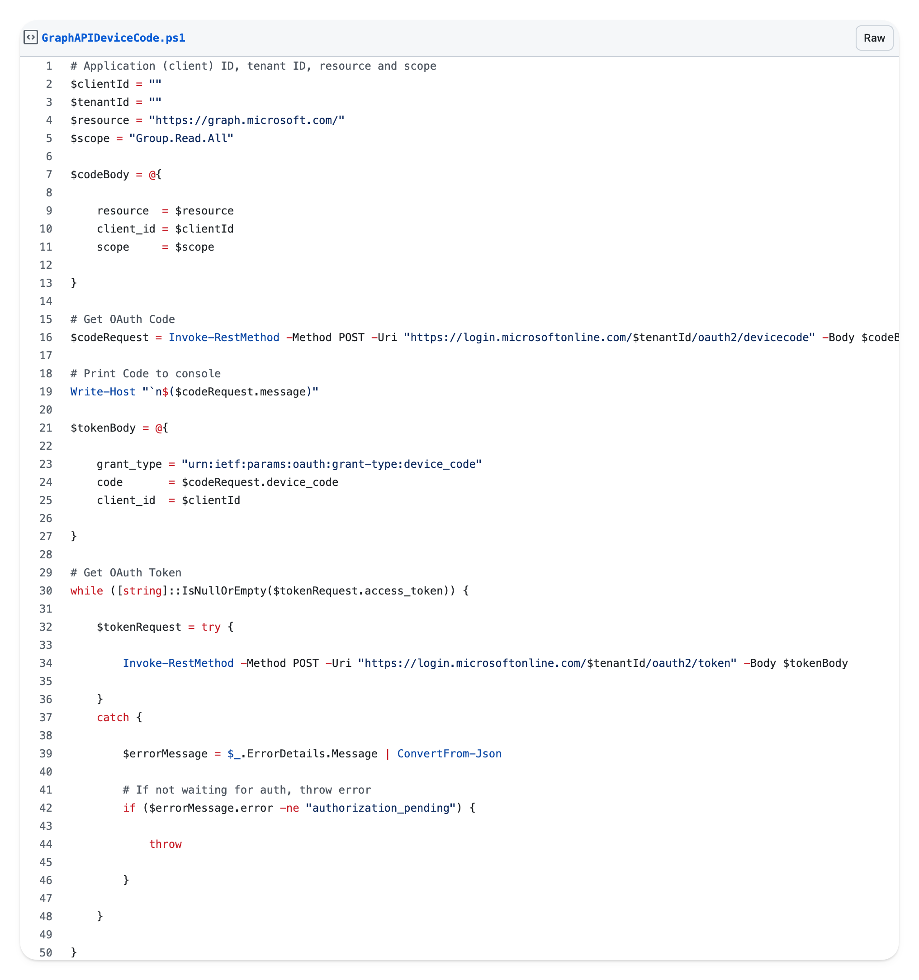
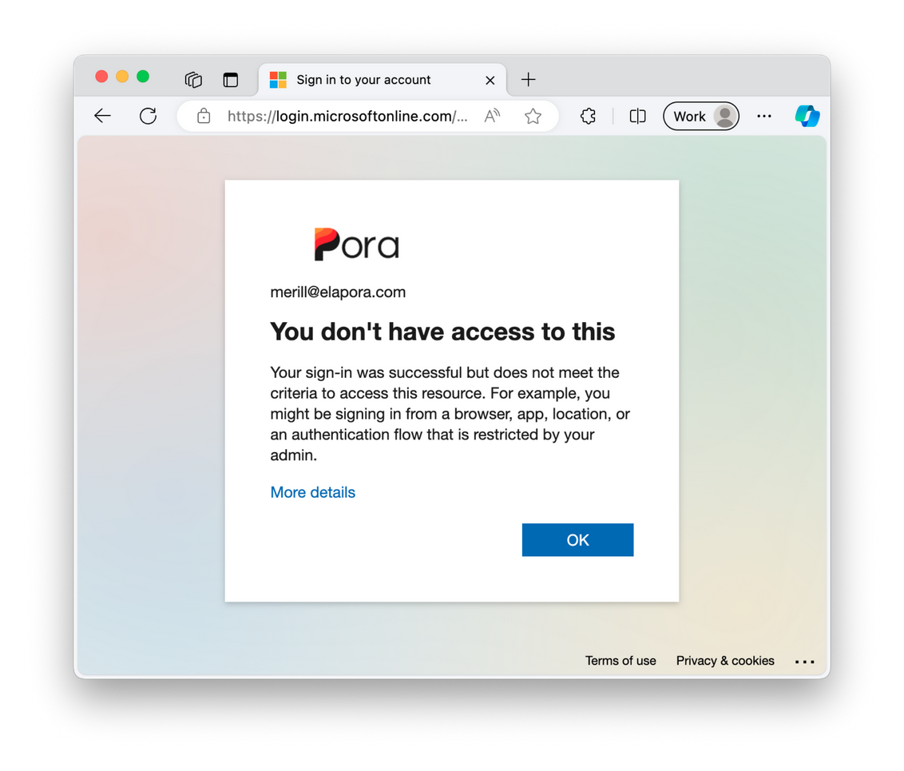
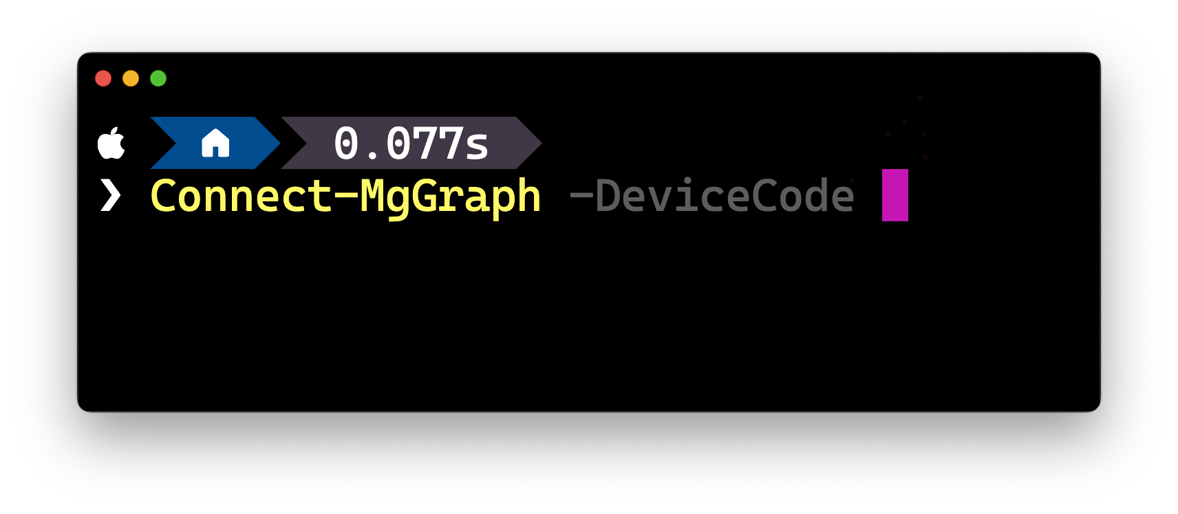
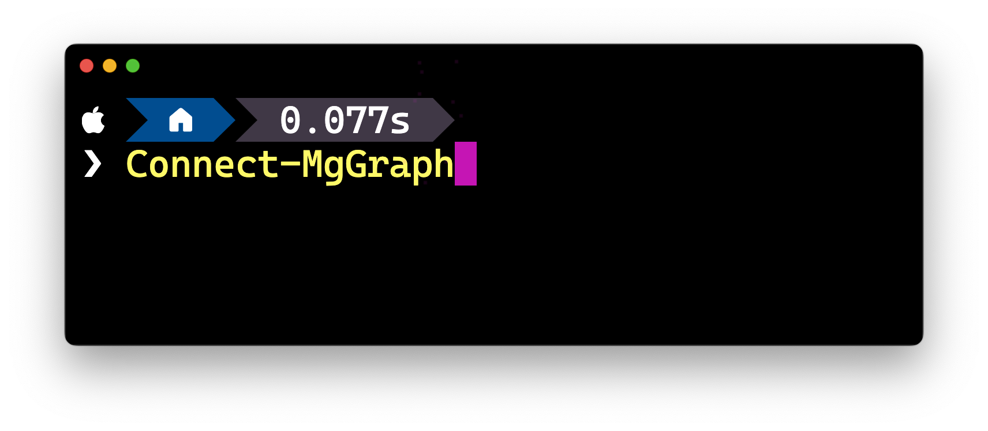
Device Code flow block
v

Slide 15

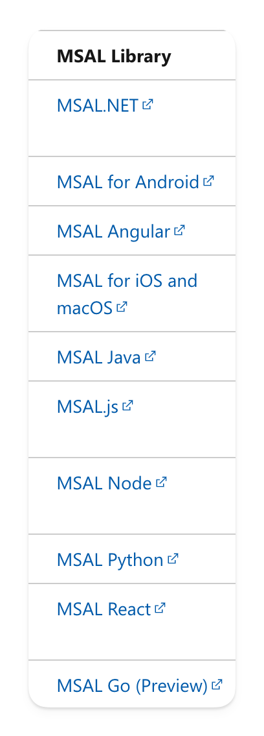
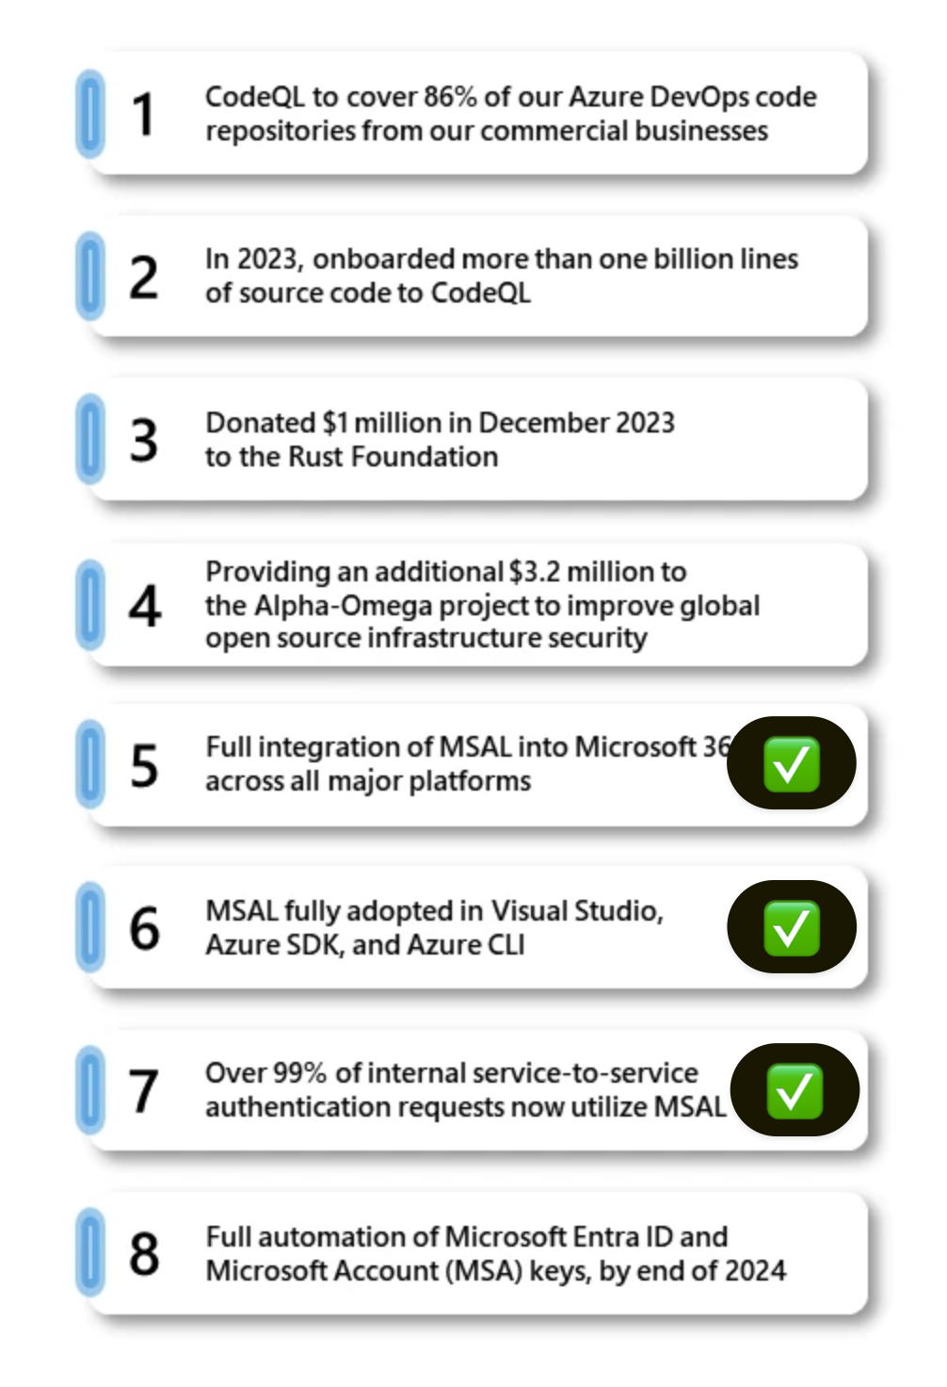
Microsoft Authentication Library (MSAL)
Industry standard implementation of OAuth2 and OpenID Connect
Supported by Microsoft
Regular security updates
Microsoft Graph PowerShell and Azure PowerShell
= MSAL in PowerShell
Notes:
Talk about how Microsoft too is moving to MSAL across all the first party products and code.

Slide 16
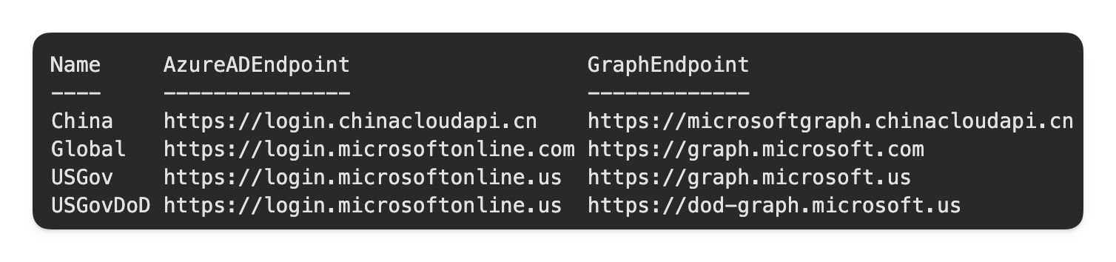
Microsoft Graph PowerShell
Supports interactive authentication
Device code flow
Access token
Delegated access with custom application
App-only access using
Certificates / Secrets
Managed Identity
Connect to ANY Microsoft cloud
Global, USGov, USGovDoD, China

Slide 17
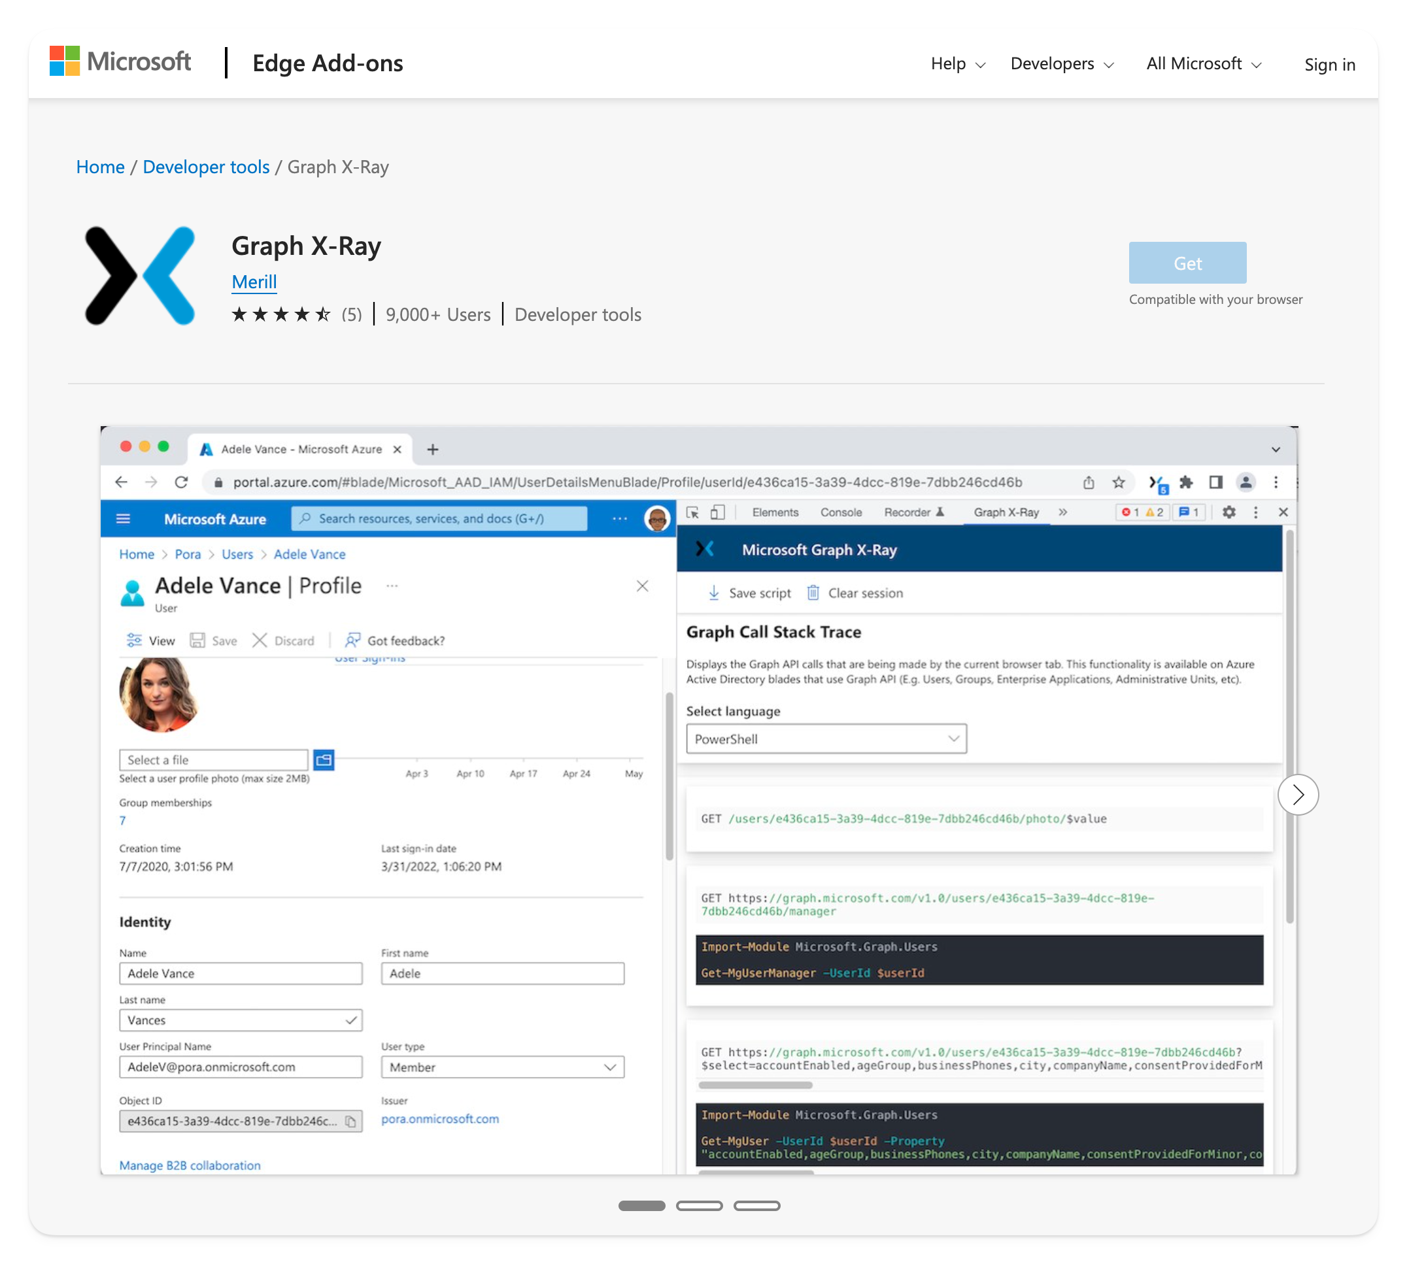
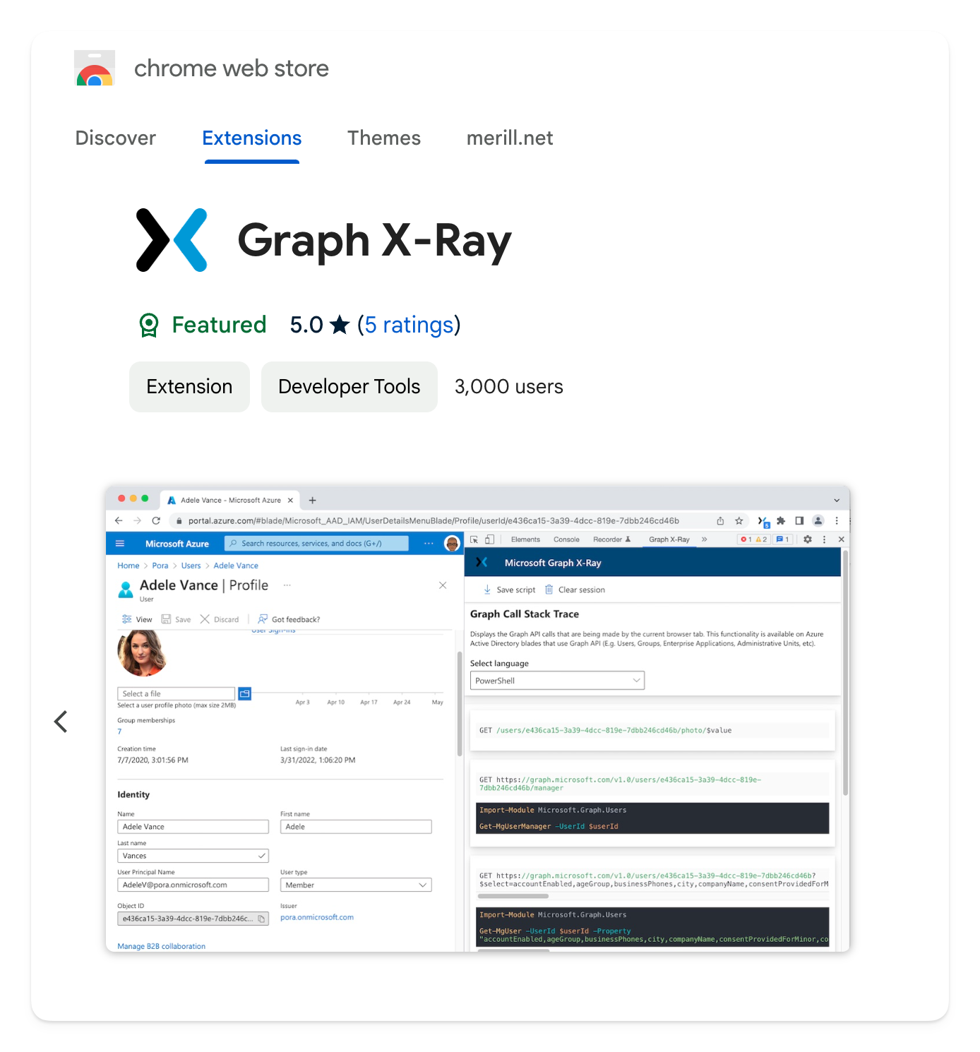
Graph X-Ray

Slide 18
Demo: Group Filters in Microsoft Entra

Slide 19
Demo: Create Device Restrictions in Microsoft Intune

Slide 20
Behind the scene: The origin story: Graph X-Ray

Slide 21
Graph Filter

Slide 22


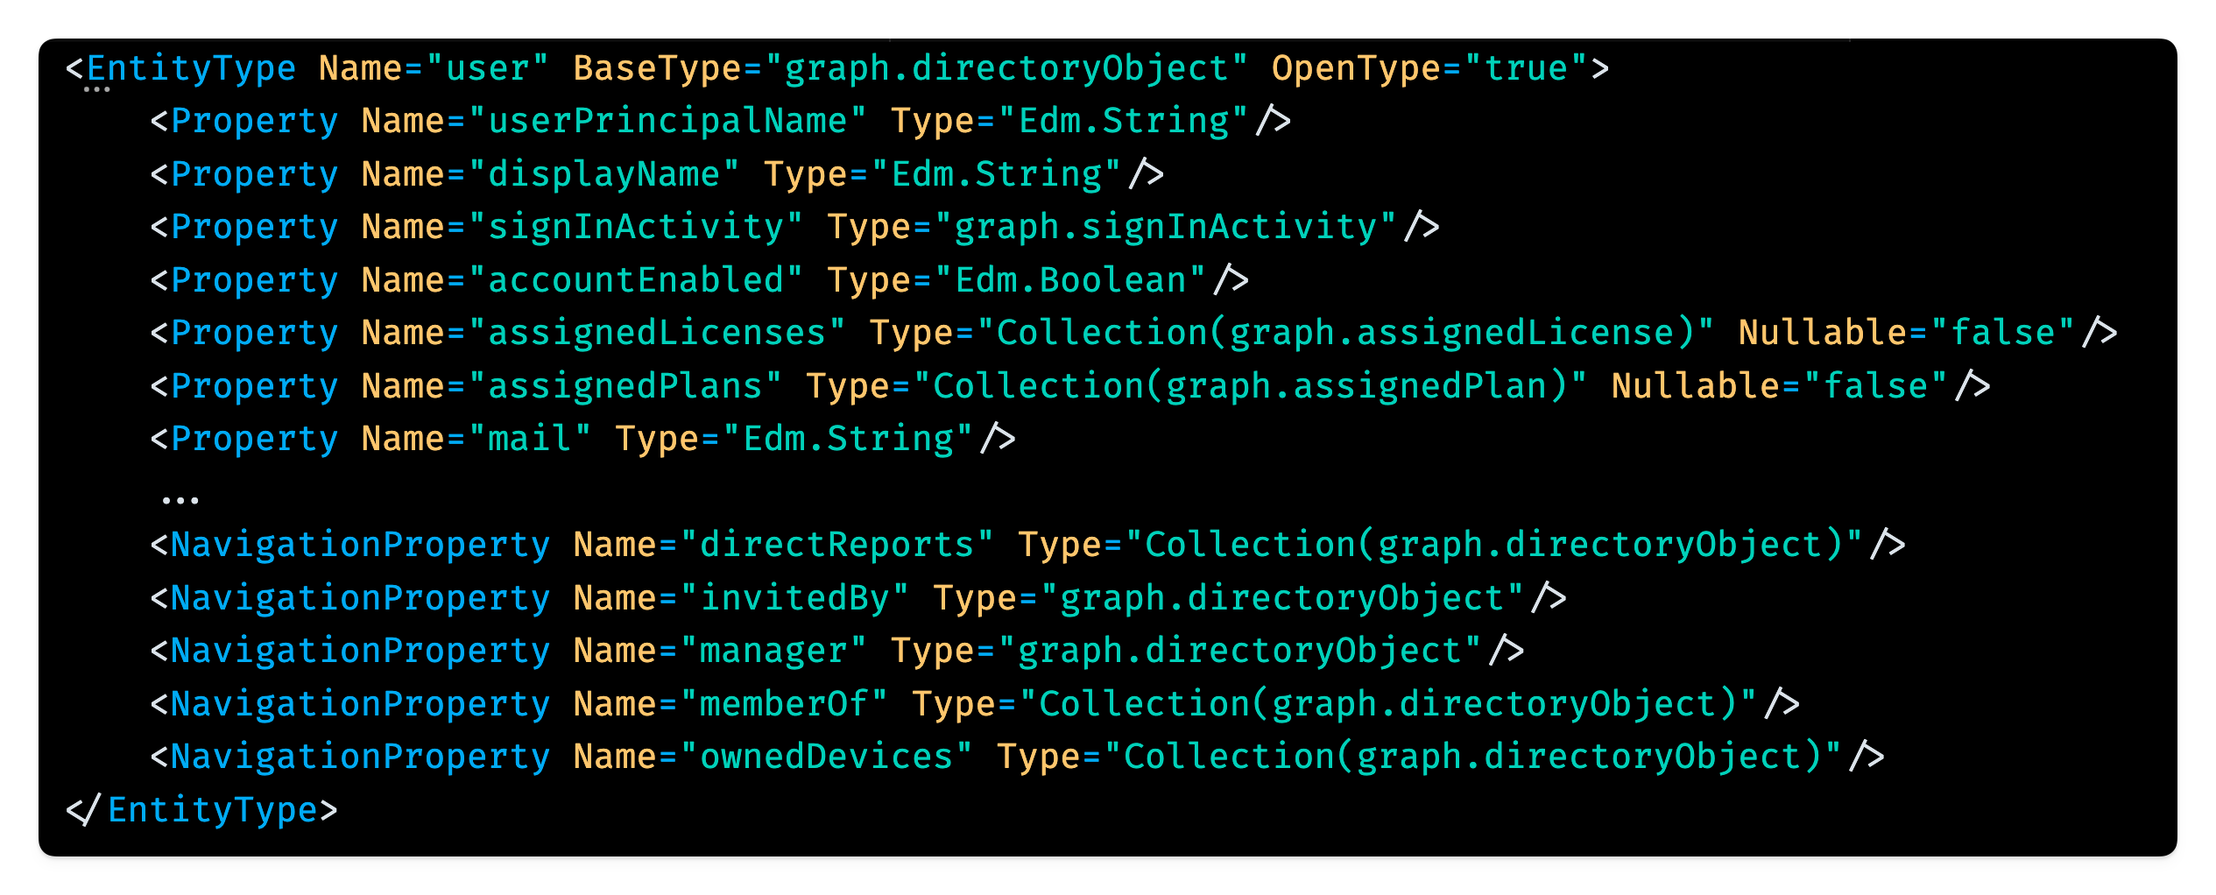
Properties vs Relationships (aka NavigationProperty)
User
[Relationship]
Manager
AssignedLicenses [Property]
Properties are a part of the entity and stored together with the parent object.
DirectReports
OwnedDevices
Filter queries can only be used with properties. Filter queries generally cannot be used with relationships*
* Except for a handful that support the $count filter (see docs)

Slide 23
Graph Filter: Properties vs Relationships
Properties
Get-MgUser -Filter 'assignedLicenses/$count ne 0' -ConsistencyLevel eventual -CountVariable count
Relationships
Get-MgUser -Filter ‘directReports/$count ne 0' -ConsistencyLevel eventual -CountVariable count

Slide 24
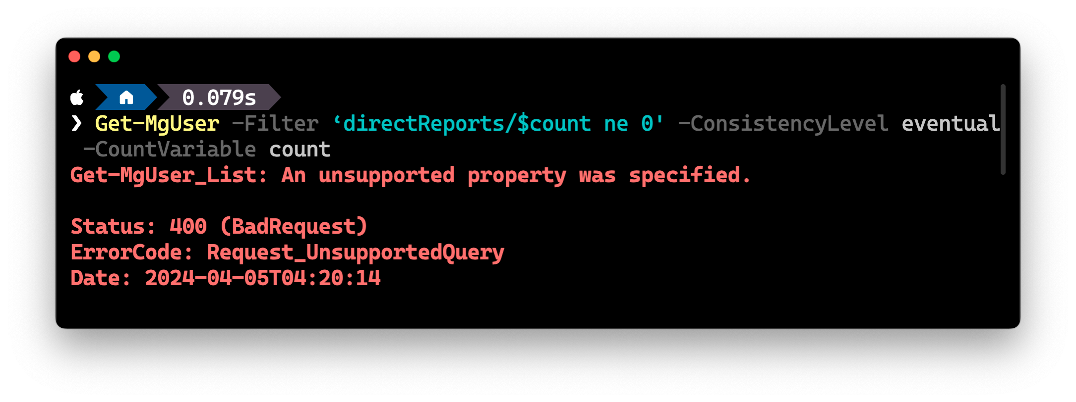
Graph Filter: Properties vs Relationships

Slide 25
Supported count $filter on navigation properties
Entity Set | Property filter | eq Count 0 | eq Count 1
applications | extensionProperties/$count | Yes | No
applications | federatedIdentityCredentials/$count | Yes | No
applications | owners/$count | Yes | Yes
groups | owners/$count | Yes | Yes
servicePrincipals | federatedIdentityCredentials/$count | Yes | No
servicePrincipals | ownedObjects/$count | Yes | Yes
servicePrincipals | owners/$count | Yes | Yes
users | ownedObjects/$count | Yes | Yes

Slide 26




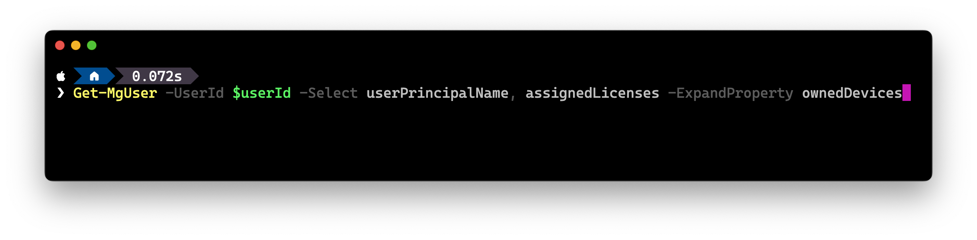
Selecting & Expanding
User
[Relationship]
Manager
AssignedLicenses [Property]
Properties → Select
Relationships → Expand
DirectReports
OwnedDevices
What is the command to get the licenses and devices owned by a user?

Slide 27
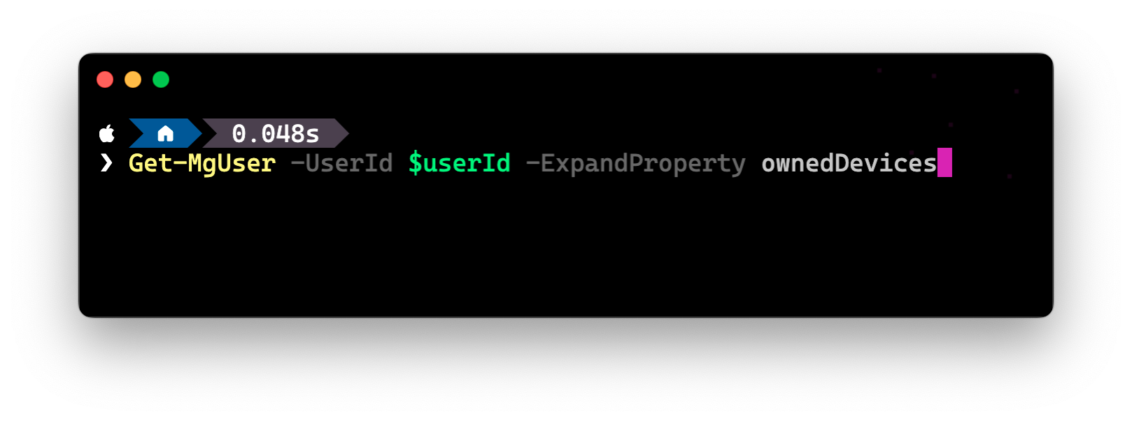
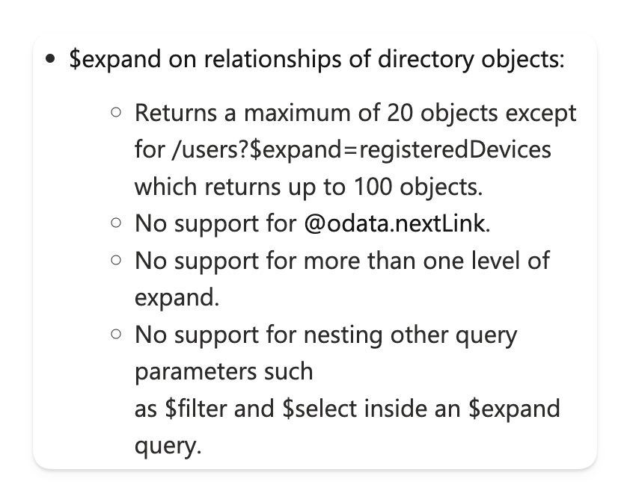

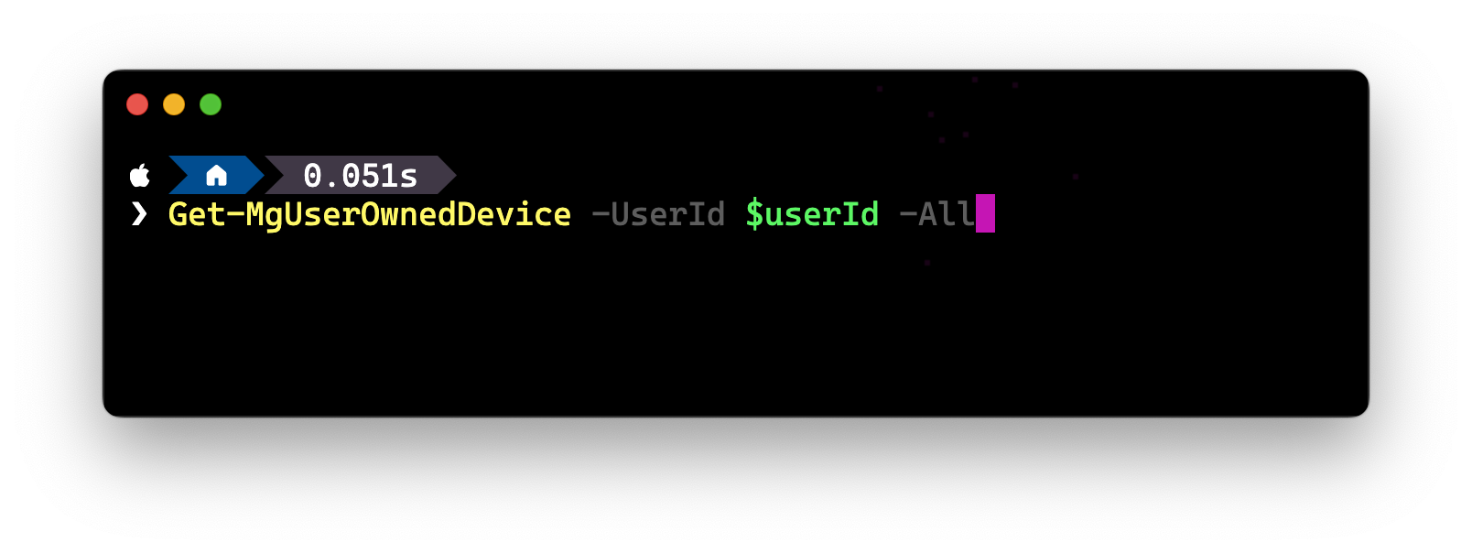
Expanding Directory Objects
Notes:
This will even page through all the results

Slide 28
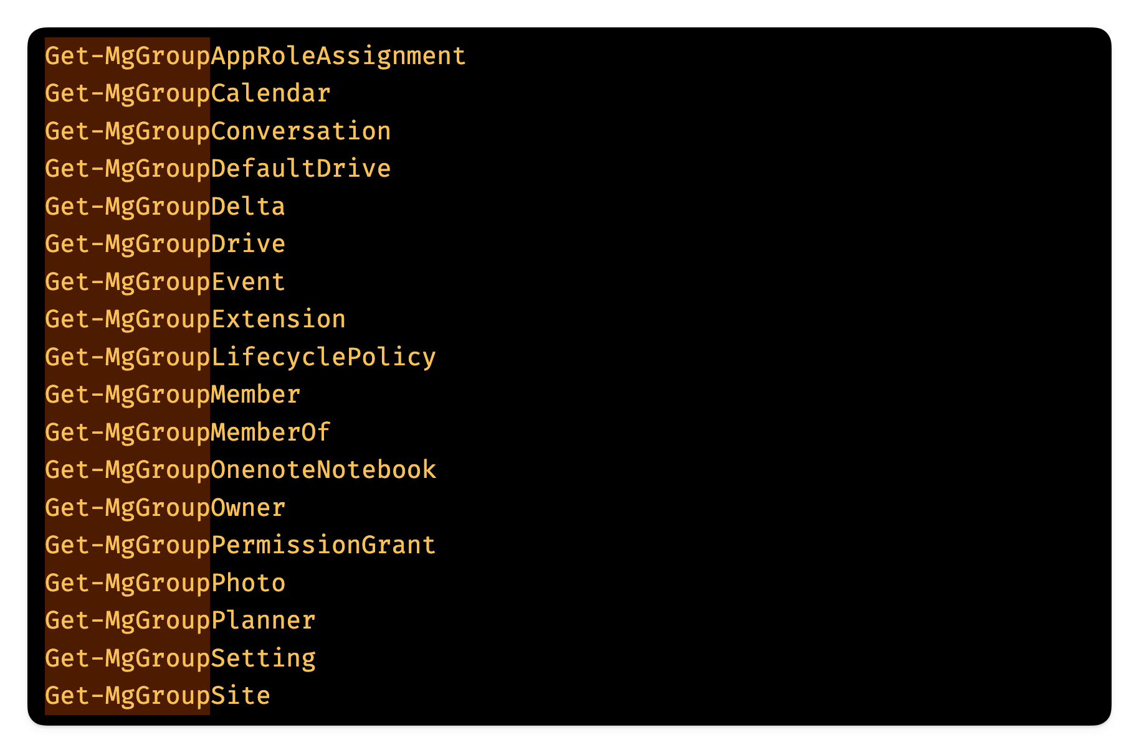

Every Graph relationship has a built-in command…

Slide 29
Advanced Queries

Slide 30









Supported Directory Objects
https://aka.ms/graph-docs/advanced-queries
administrativeUnits
applications
appRoleAssignments
devices
groups
oAuth2PermissionGrants
orgContacts
servicePrincipals
users
Notes:
If you are wondering why we are not using advanced queries for everything, it’s because we specifically need to enable it for certain Entities and navigation properties.
These are the ones that we support at the moment, but we are working to enable more directory object types.

Slide 31

Advanced Queries Architecture
REST Directory Service
Directory Store
Microsoft
Graph
Sync Engine
$count=true
ConsistencyLevel=eventual
Advanced Queries Service
Index Store
Notes:
We have Graph that we all know and love
And when it receive a request for an Identity workload (Entra ID Objects), it will redirect the call to RDS
That will ultimately execute the read/write operation in the core directory store. Very simple SOA.
This directory store is the same AD store from over 20 years ago (before Azure even existed), and it has several limitations.
Now, as the Fundamental Theorem of Software Engineering says: “All problems in computer science can be solved by another level of indirection”, we introduced the Advanced Query service about 3 years ago.
Let’s assume MS Graph redirects the query to Advanced Query Service instead of RDS (we’ll see later how)
The data is read from another store that keeps indexes and data in a high performant graph database.
A sync engine will pushe every change happening in the directory to the index store.
Now, there are a couple issues here: how microsoft graph knows where to redirect a query requesting Entra ID Objects?
We have to use these magic parameters that we understand you all hate, but know we are working to at least remove $count=true.
Second, syncing data is an asynchronous process. Due to replication delays in the Directory Store itself, and to guarantee high availability, the data in the Index store can lag several minutes behind the directory. When you write something using RDS and you immediately read using AQ, you might not see the updated object right after your write. That’s why ConsistencyLevel header will still be necessary.
But we are also working on a mitigation for this, reducing the sync time from minutes to seconds.

Slide 32
Graph Advanced Query
Get-MgUser -Filter 'assignedLicenses/$count ne 0' -ConsistencyLevel eventual -CountVariable count
Notes:
The consistency level and court variable should now make sense.

Slide 33
OData Casting in PowerShell

Slide 34
DirectoryObject
DirectoryObject
(base type)
The directoryObject type is the base type for many directory entity types including User, Group and Device.
Application
AdministrativeUnit
Device
DirectoryRole
Group
User
ServicePrincipal

Slide 35
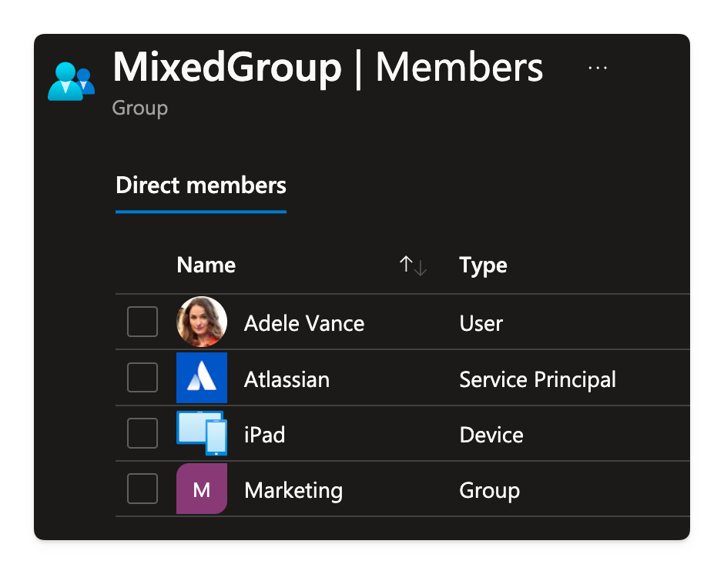
A security group with different types of directory objects
Let’s find out how to work with Graph PowerShell when dealing with commands that can return different types of objects.

Slide 36
Graph PowerShell Tips

Slide 37
Tip #1: Online Parameter Get-Help <cmd> -Online

Slide 38
Tip #2: ToJsonString()

Slide 39
Tip #3: FindPermissions

Slide 40
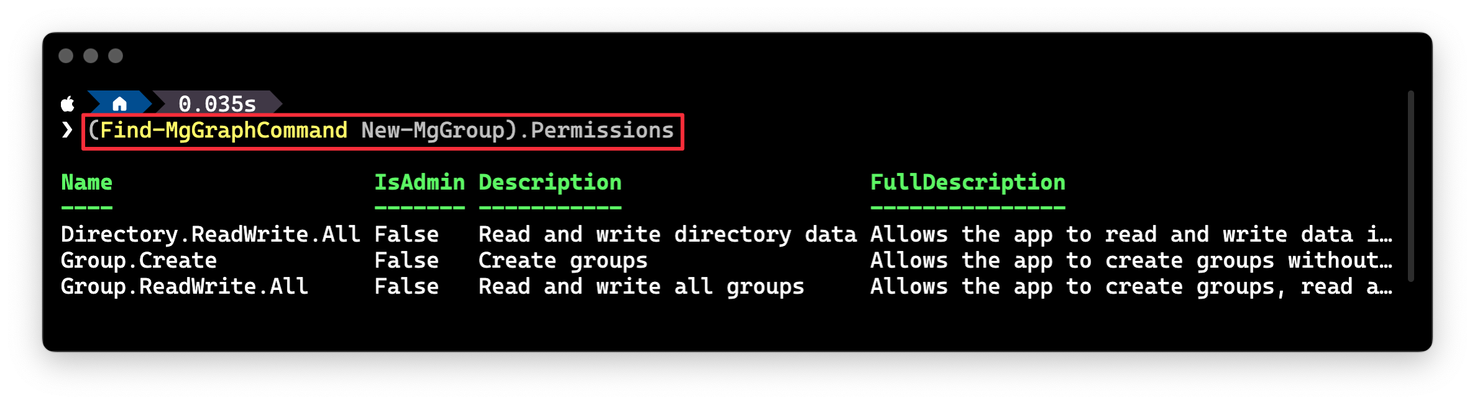
Find-MgGraphCommand

Slide 41
Tip #4: Count commands

Slide 42
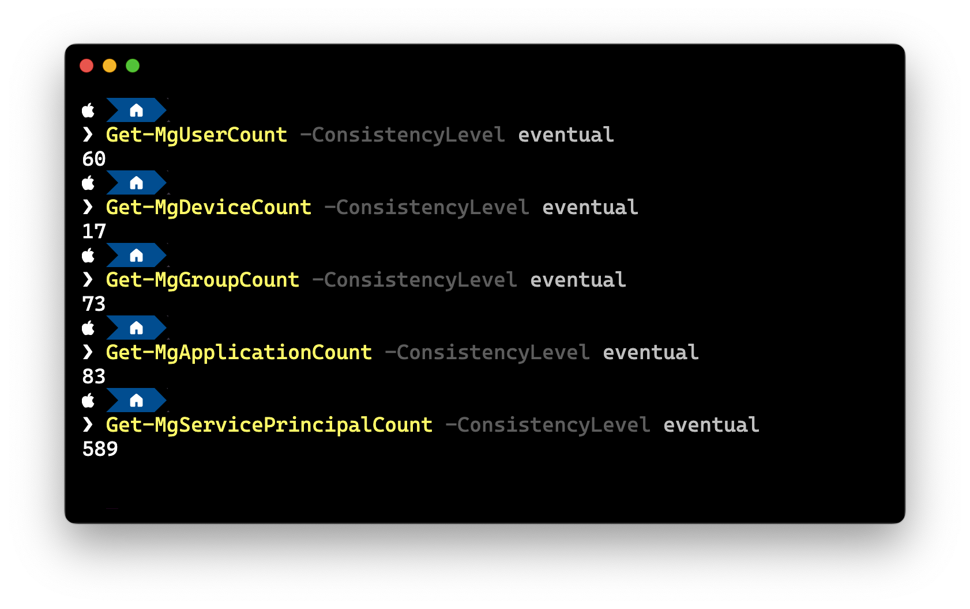
Get*MgCount
These ready-made commands are super easy to remember!

Slide 43
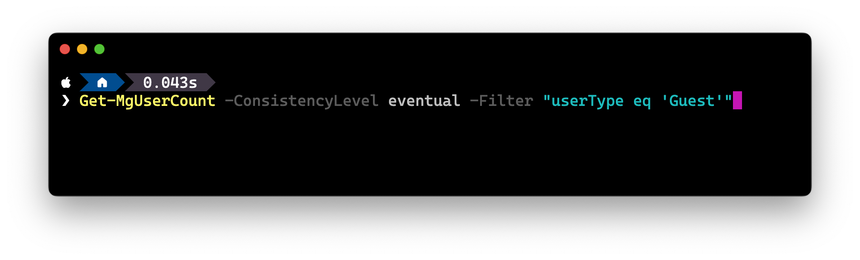
Bonus tip! You can even use Filter with them…

Slide 44
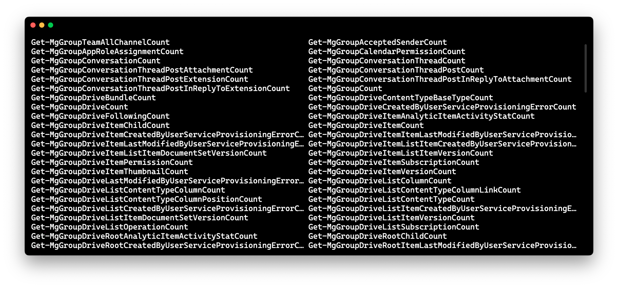
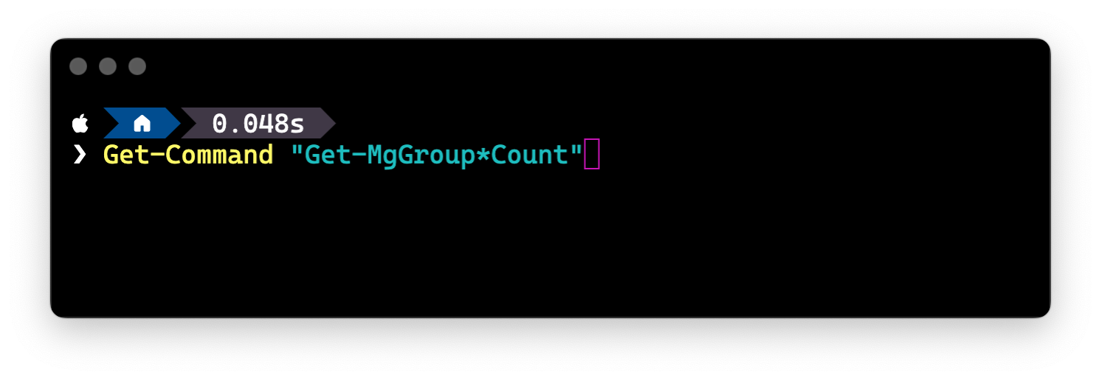
You get a count command for every relationship!

Slide 45
Tip #5: Invoke-MgGraphRequest

Slide 46
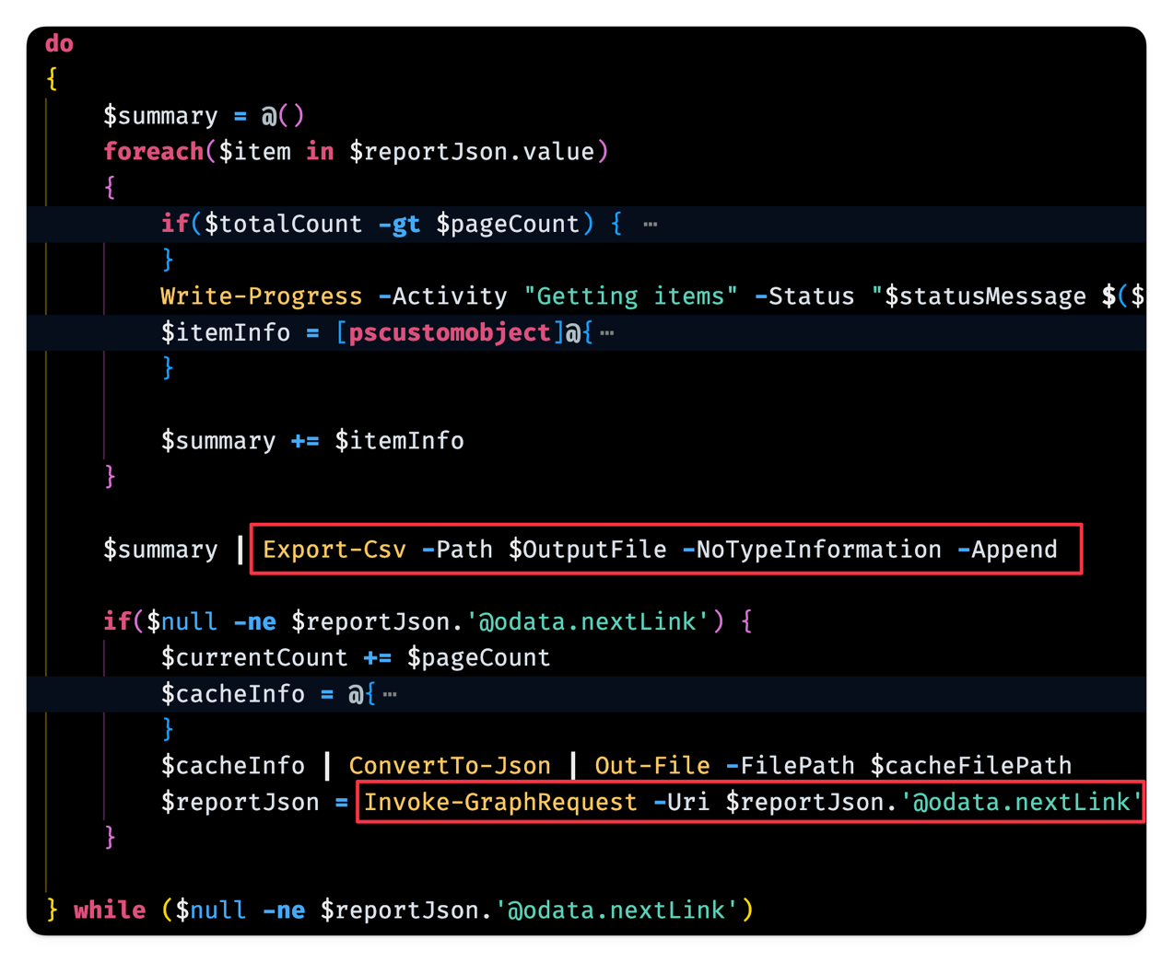
Sometimes you need to do something that is not possible out of the box
Take for example querying large tenants with a million users, devices or servicePrincipals...
The –All can run for hours paging through results.
How do you add support for resuming and showing progress?

Slide 47
Tip #6: Bookmark this!

Slide 48
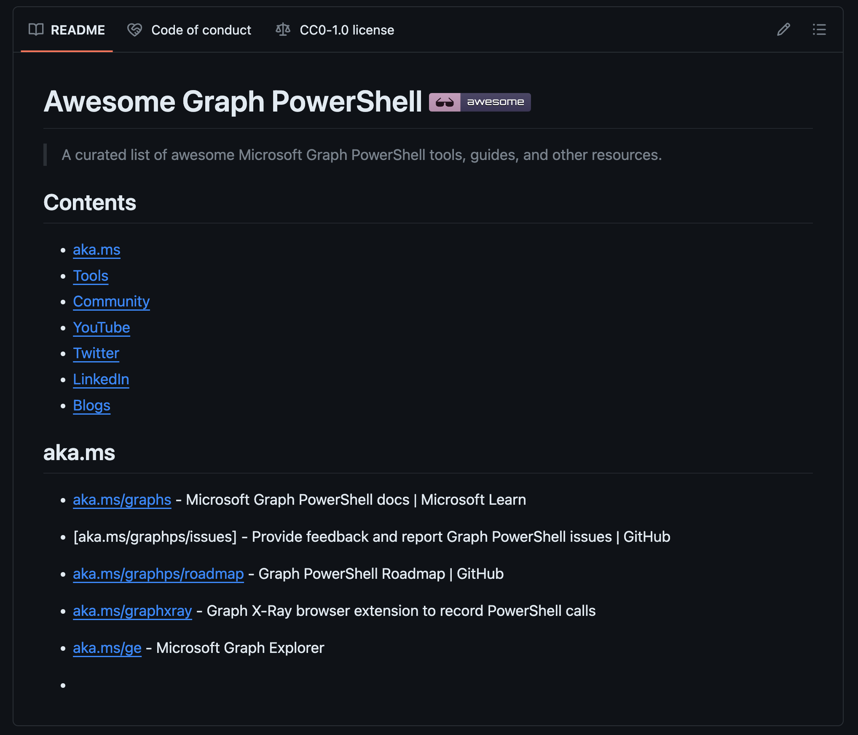
aka.ms/Awesome-GraphPS
Links to all things Graph PowerShell
Please submit a PR with your suggestions!
TODO - UPDATE

Slide 49
Coming soon to Microsoft Graph PowerShell

Slide 50
What’s next for Microsoft Graph PowerShell
1
2
3
Piping support
Docs update
Kiota…
Finally!!!
Quick link to Graph API for PowerShell commands
AutoRest to Kiota

Slide 51
We’re making substantial new and future investments in the PowerShell experience for managing Entra. Please continue to monitor this space as we announce exciting improvements in the coming months.
Kristopher Bash
Product Manager, Microsoft Graph

Slide 52
Thank you

Slide 53

THANK YOU
Please review this session

